Slide 1
QV-SMART PHONE

Slide 2
Is Camera loaded statically or dynamically?
Continued...
2

Slide 3
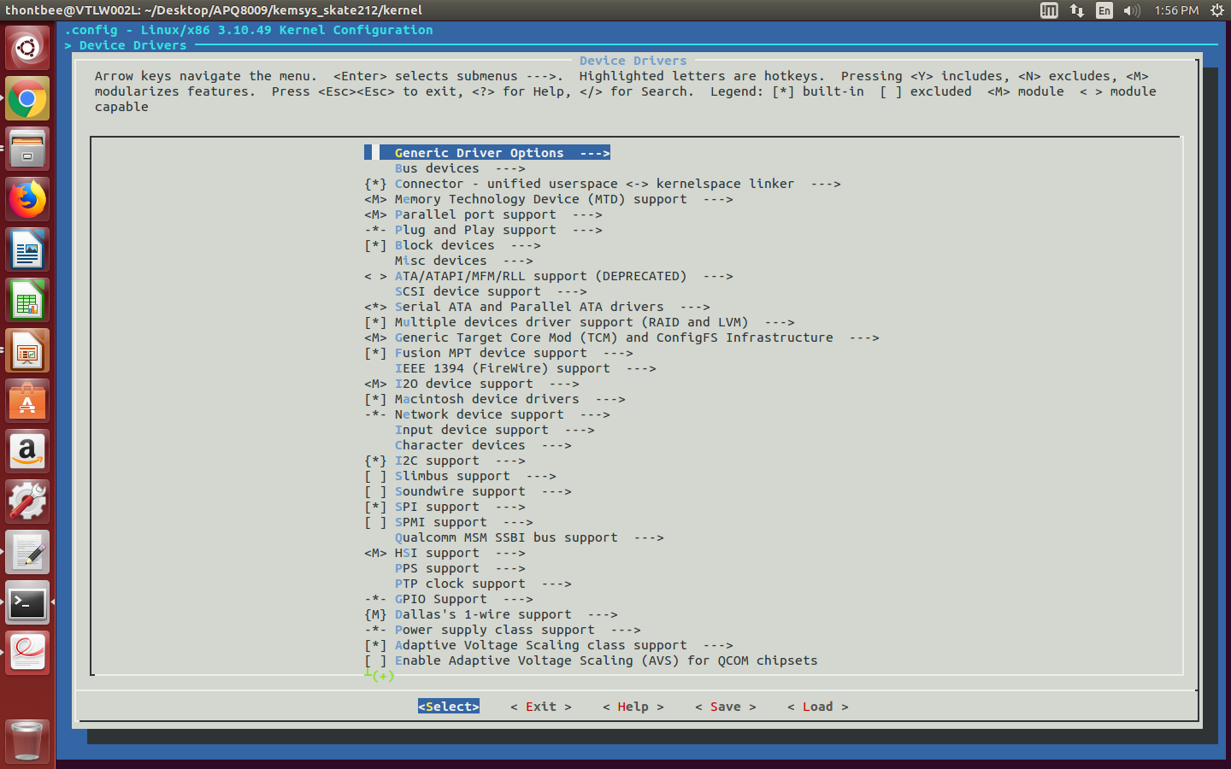
GUI after make menuconfig...

Slide 4
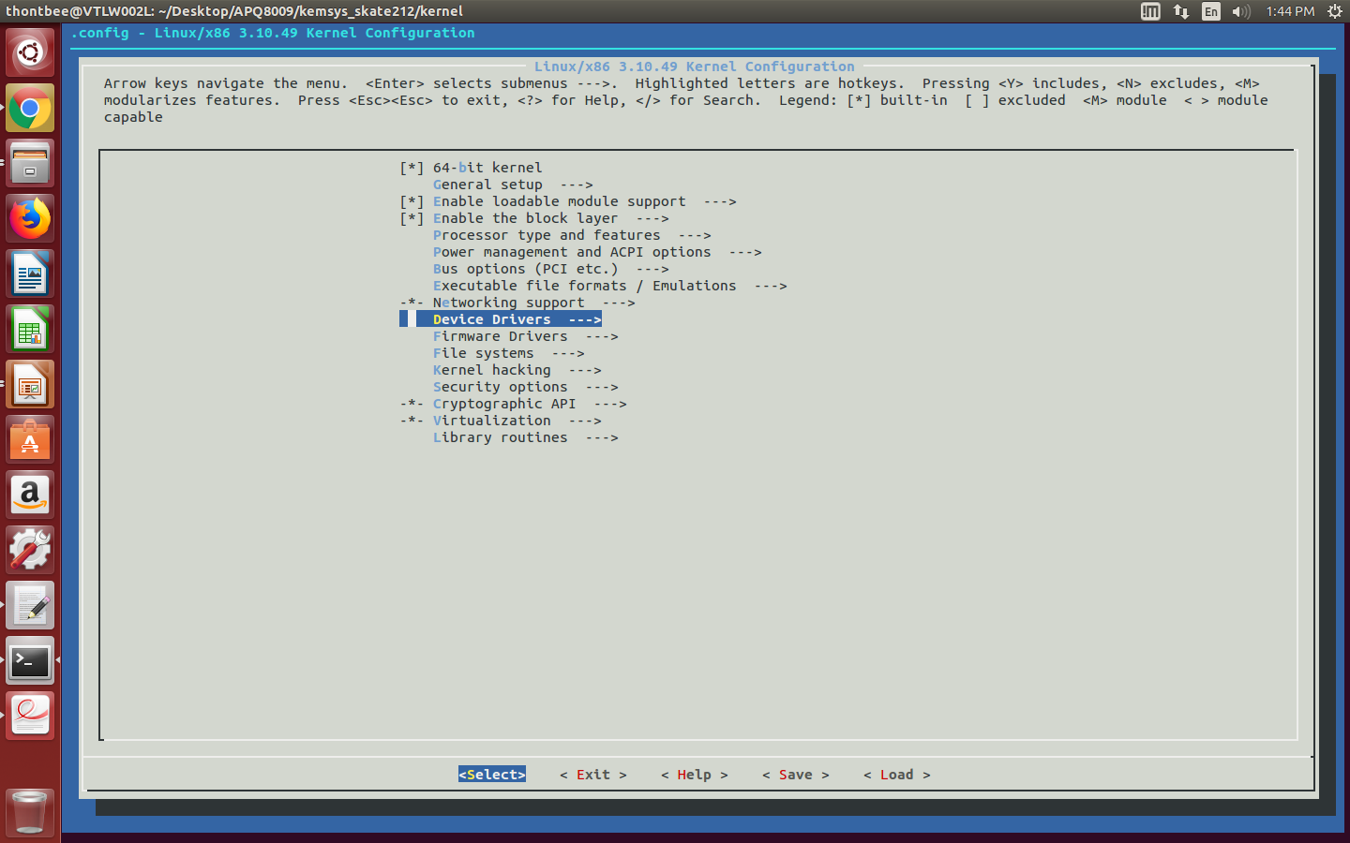
To know the presence of camera driver for ov8865 sensor.

Slide 5
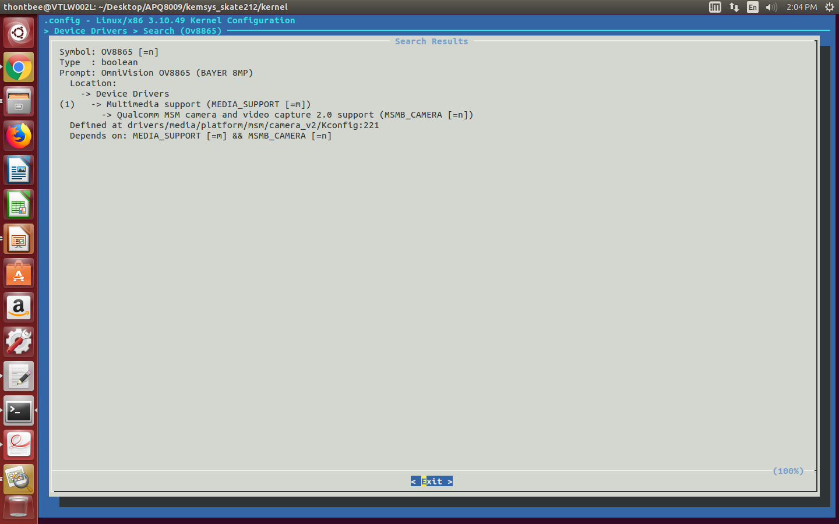
GUI config file for ov8865

Slide 6
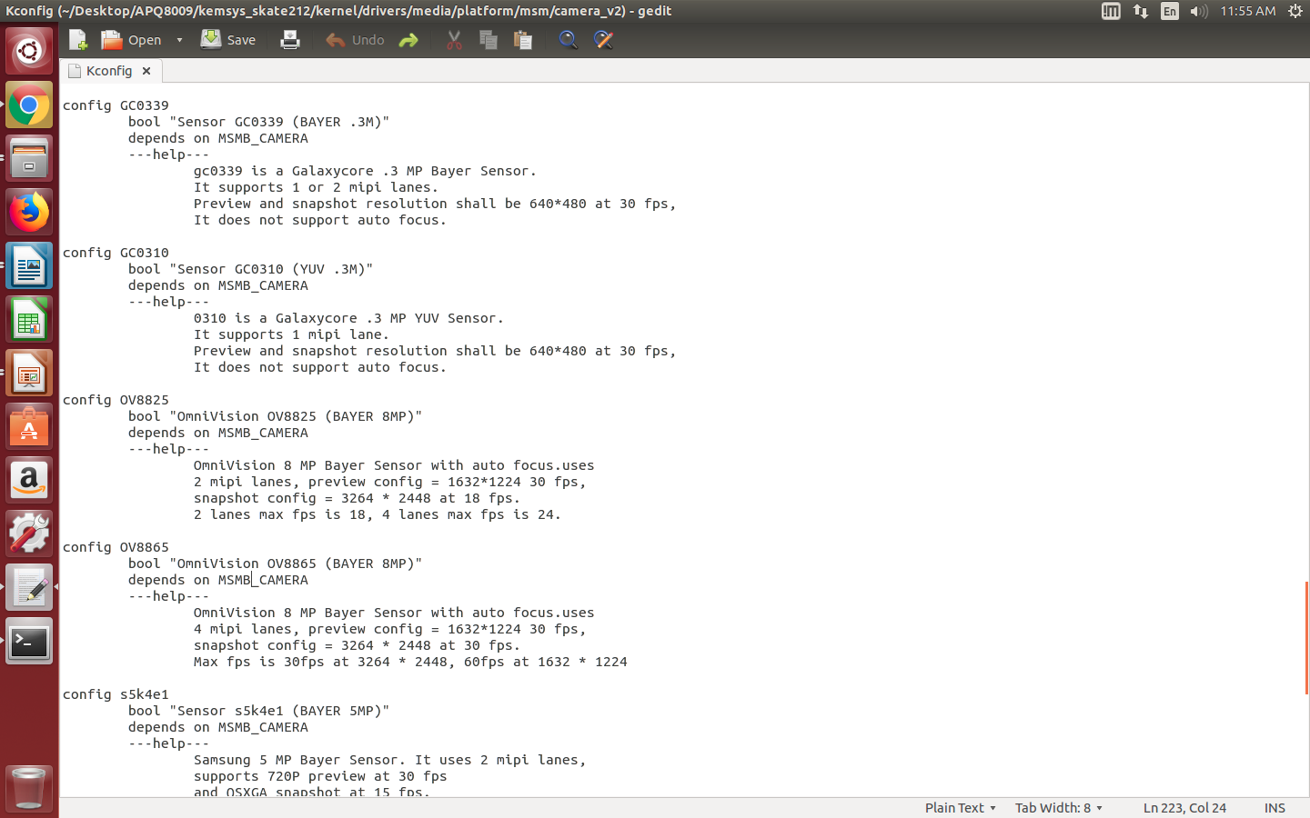
kconfig file for ov8865

Slide 7
Camera module supported API'S
1

Slide 8
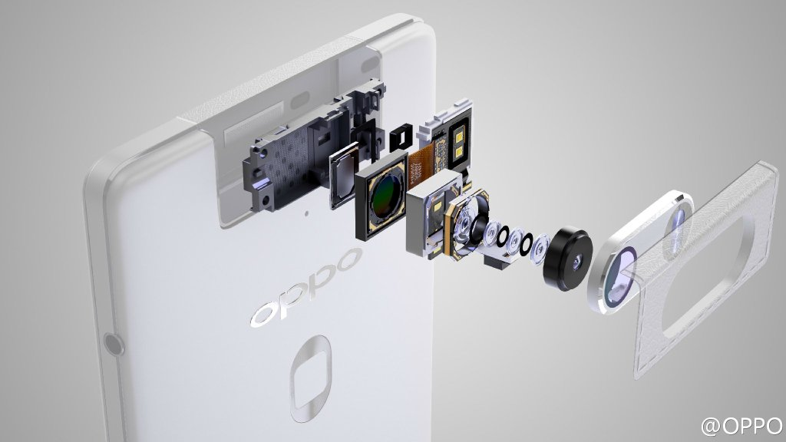
Introduction
2

Slide 9
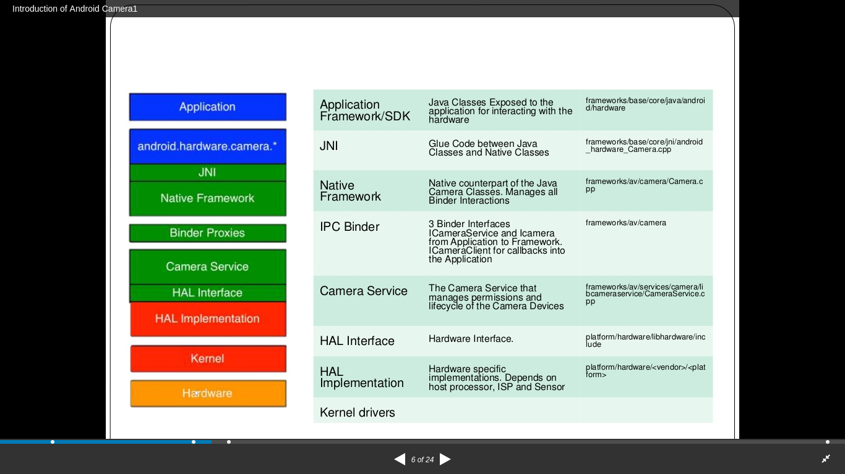
Architecture path of camera driver
2
3

Slide 10
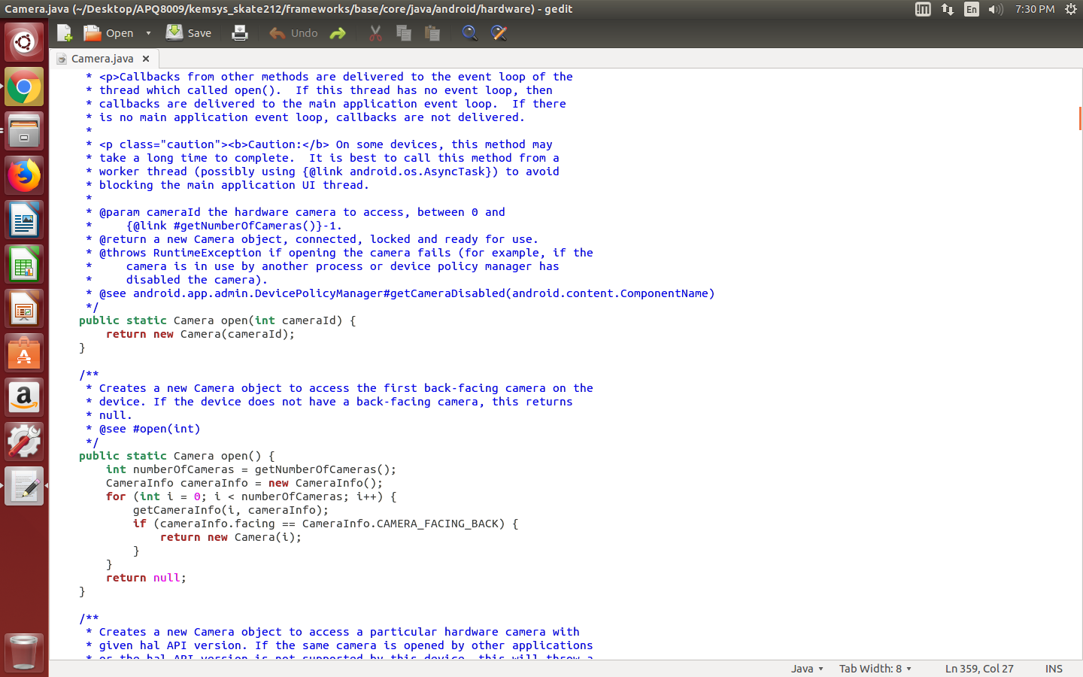
Framwork/base/core/java/android/hardware/camera.java

Slide 11
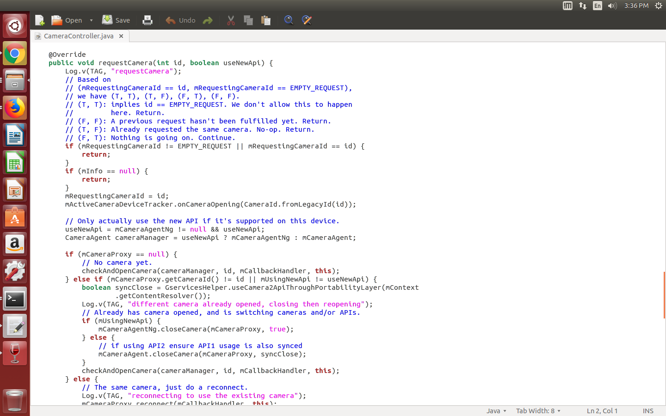
Desktop/APQ8009/kemsys_skate212/packages/apps/Camera2/src/com/android/camera/app/CameraController.java
Continued...
3

Slide 12
5

Slide 13
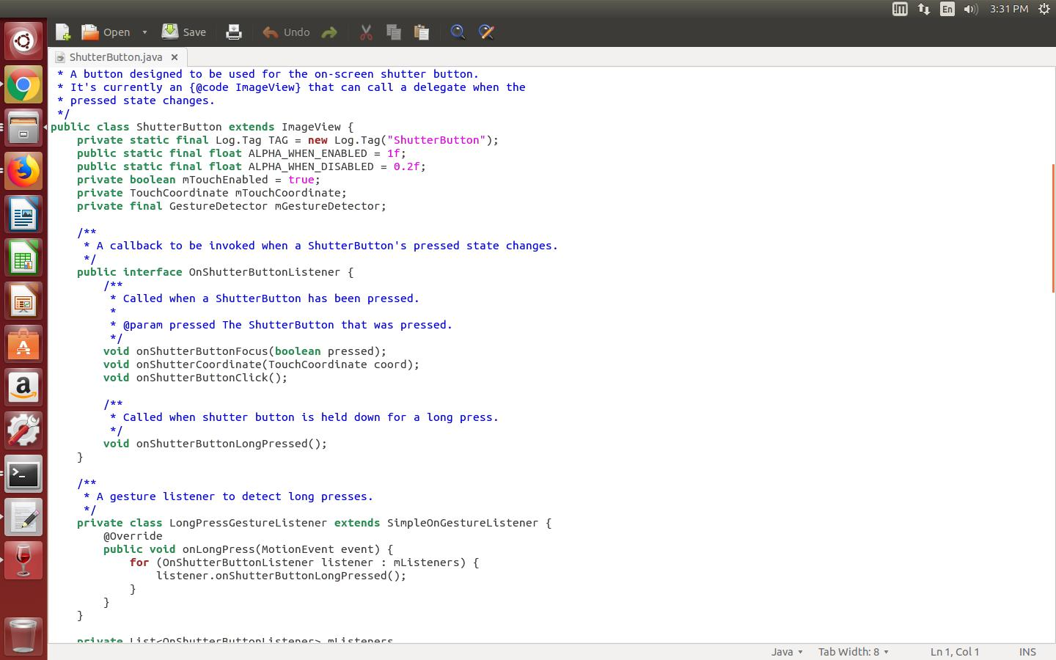
home/thontbee/Desktop/APQ8009/kemsys_skate212/packages/apps/Camera2/src/com/android/camera/ShutterButton.java
Continued...
5

Slide 14
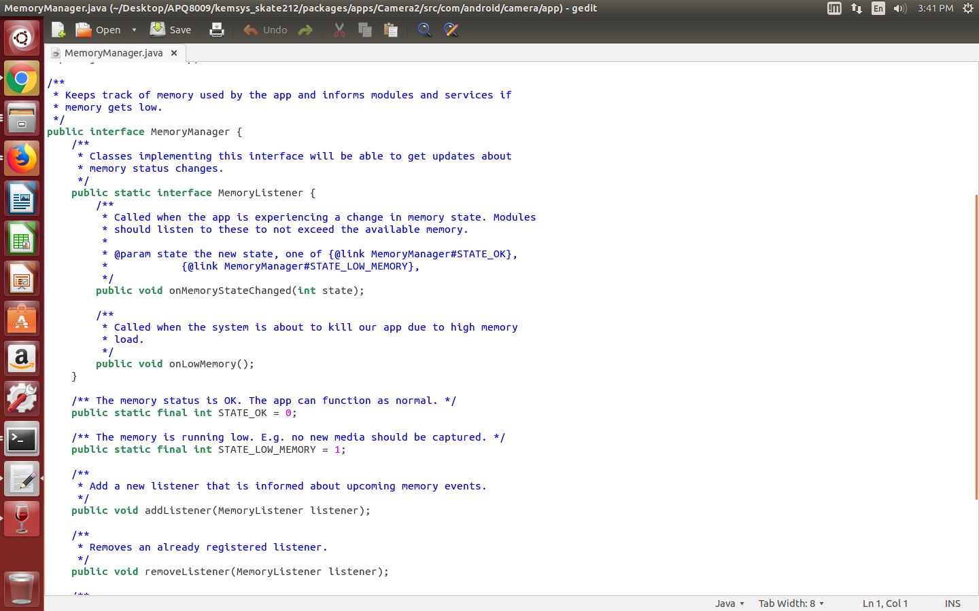
home/thontbee/Desktop/APQ8009/kemsys_skate212/packages/apps/Camera2/src/com/android/camera/ShutterButton.java

Slide 15
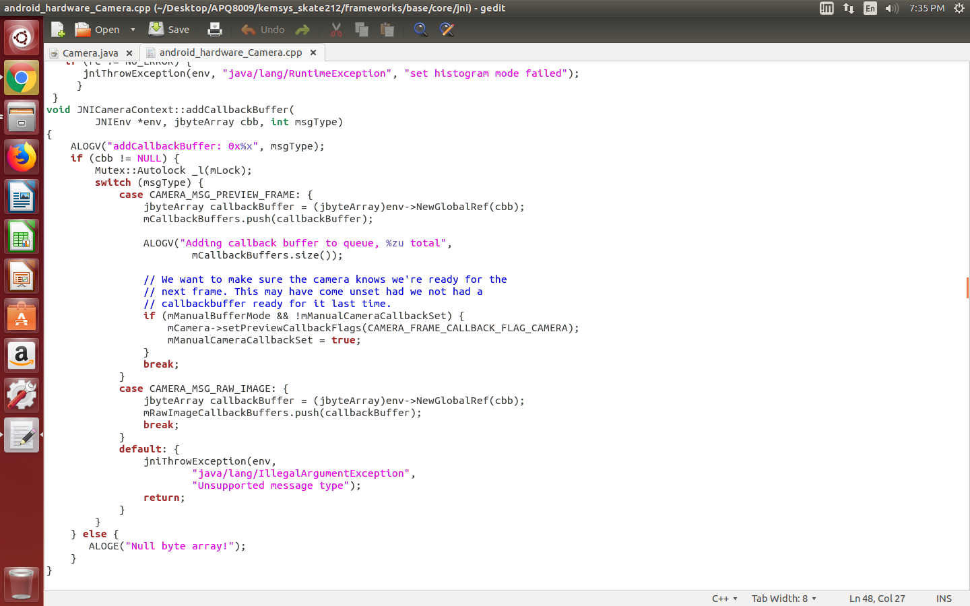
home/thontbee/Desktop/APQ8009/kemsys_skate212/framework/base/core/jni/android_hardware_camera.cpp

Slide 16
home/thontbee/Desktop/APQ8009/kemsys_skate212/packages/apps/Camera2/src/com/android/camera/ShutterButton.java

Slide 17
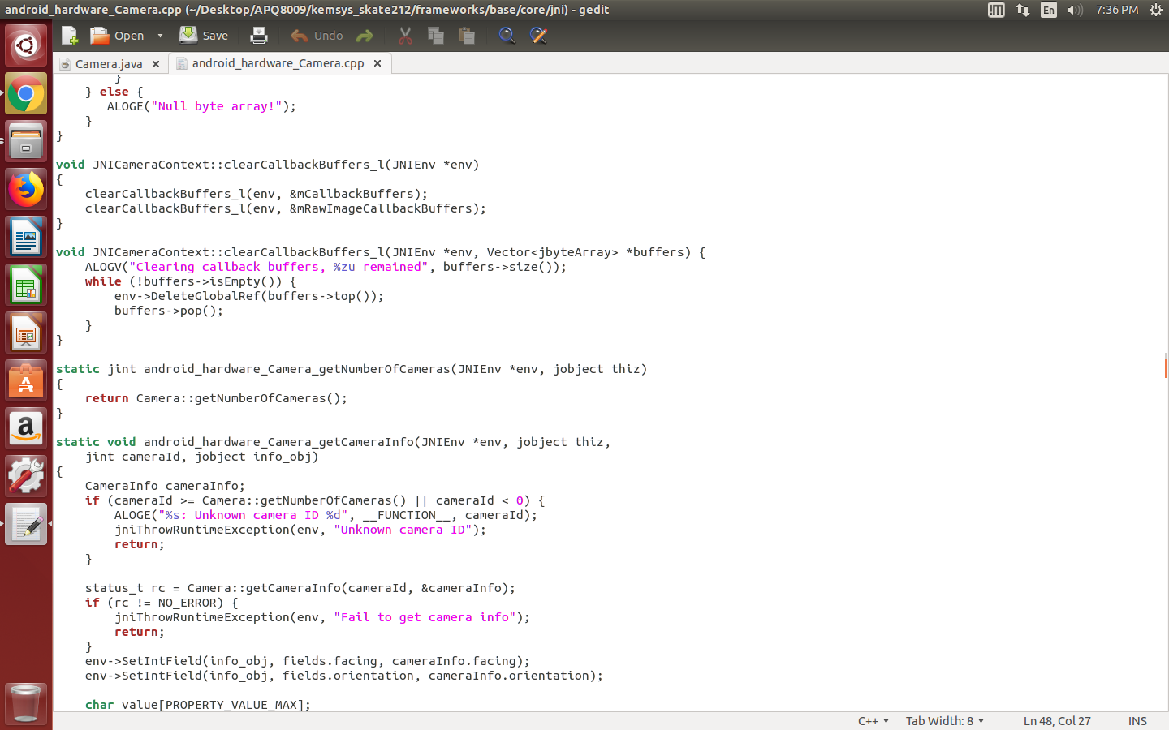
home/thontbee/Desktop/APQ8009/kemsys_skate212/framework/base/core/jni/android_hardware_camera.cpp

Slide 18
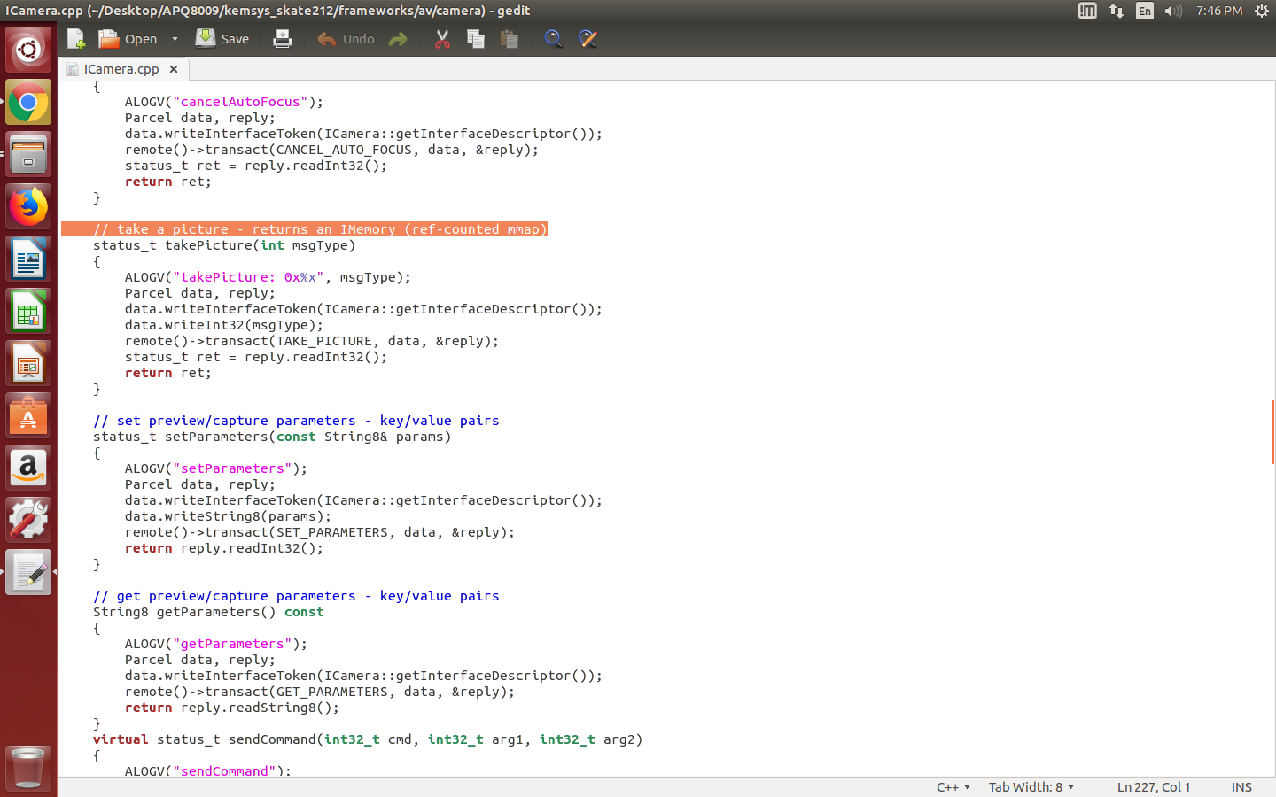
home/thontbee/Desktop/APQ8009/kemsys_skate212/framework/av/camera/Icamera.cpp

Slide 19
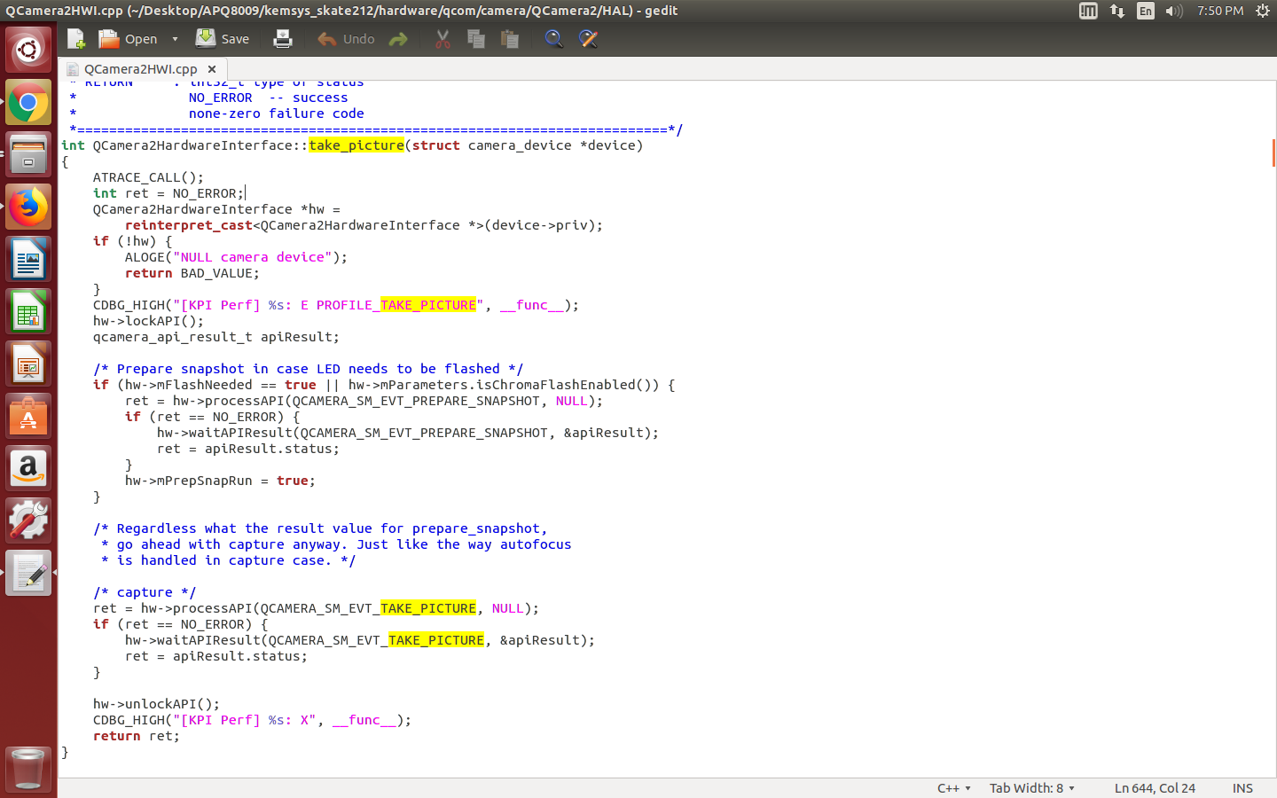
home/thontbee/Desktop/APQ8009/kemsys_skate212/hardware/qcom/camera/Qcamera2/HAL/Qcamera2HWI.cpp

Slide 20
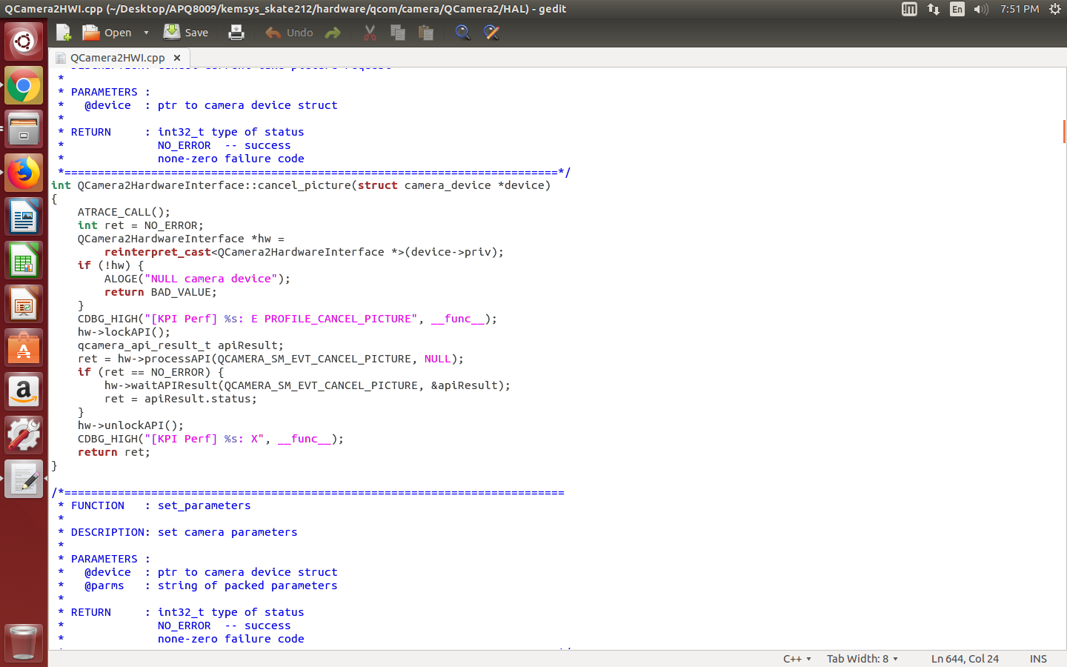

Slide 21
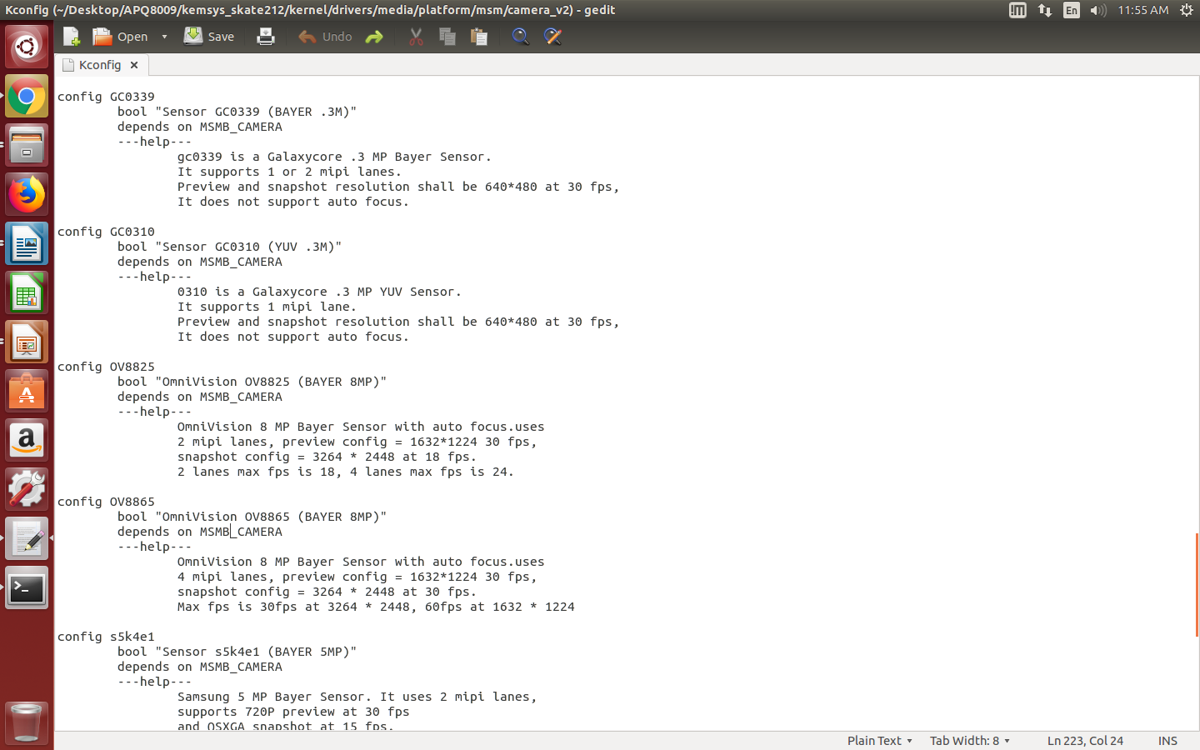
home/thontbee/Desktop/APQ8009/kemsys_skate212/kernel/drivers/media/platform/msm/camera_v2/Kconfig

Slide 22
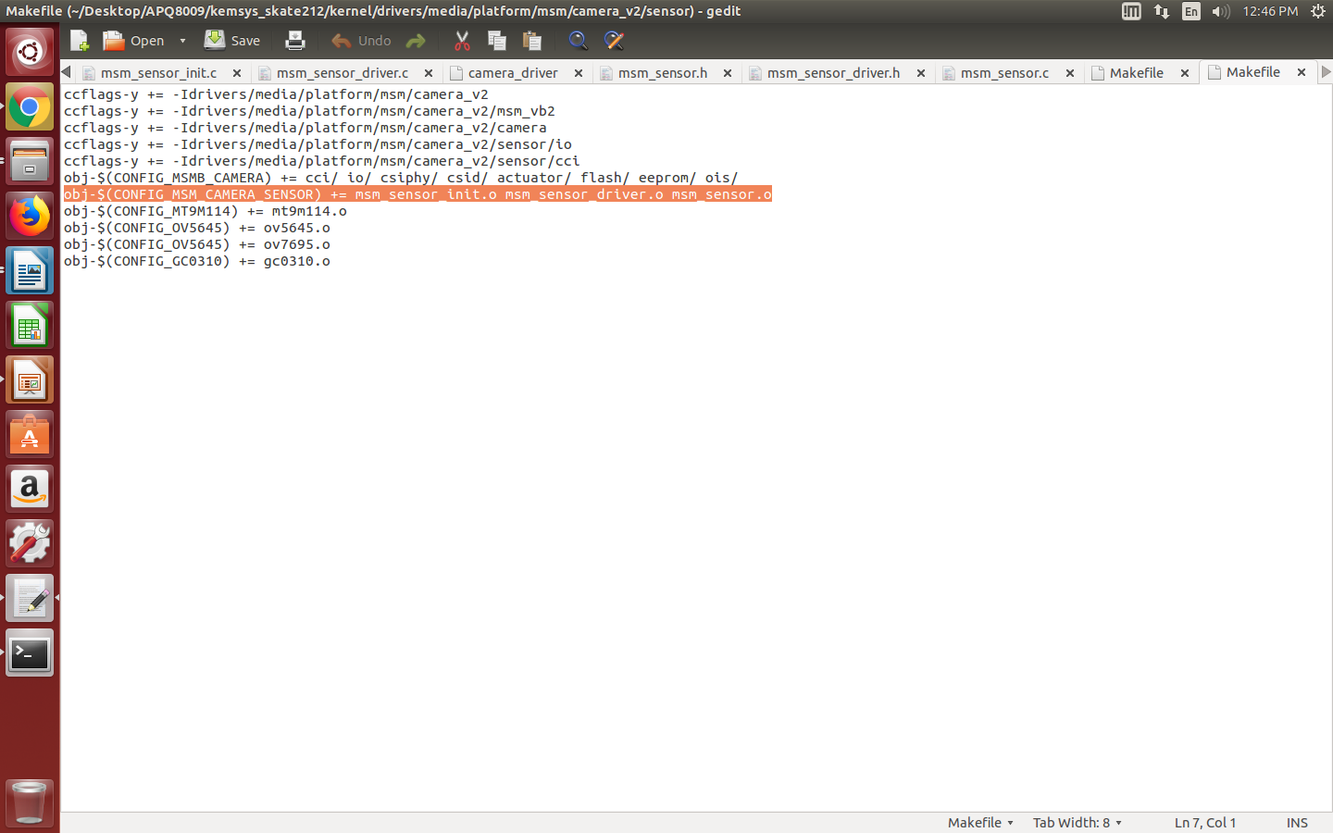
home/thontbee/Desktop/APQ8009/kemsys_skate212/kernel/drivers/media/platform/msm/camera_v2/sensor/Makefile

Slide 23
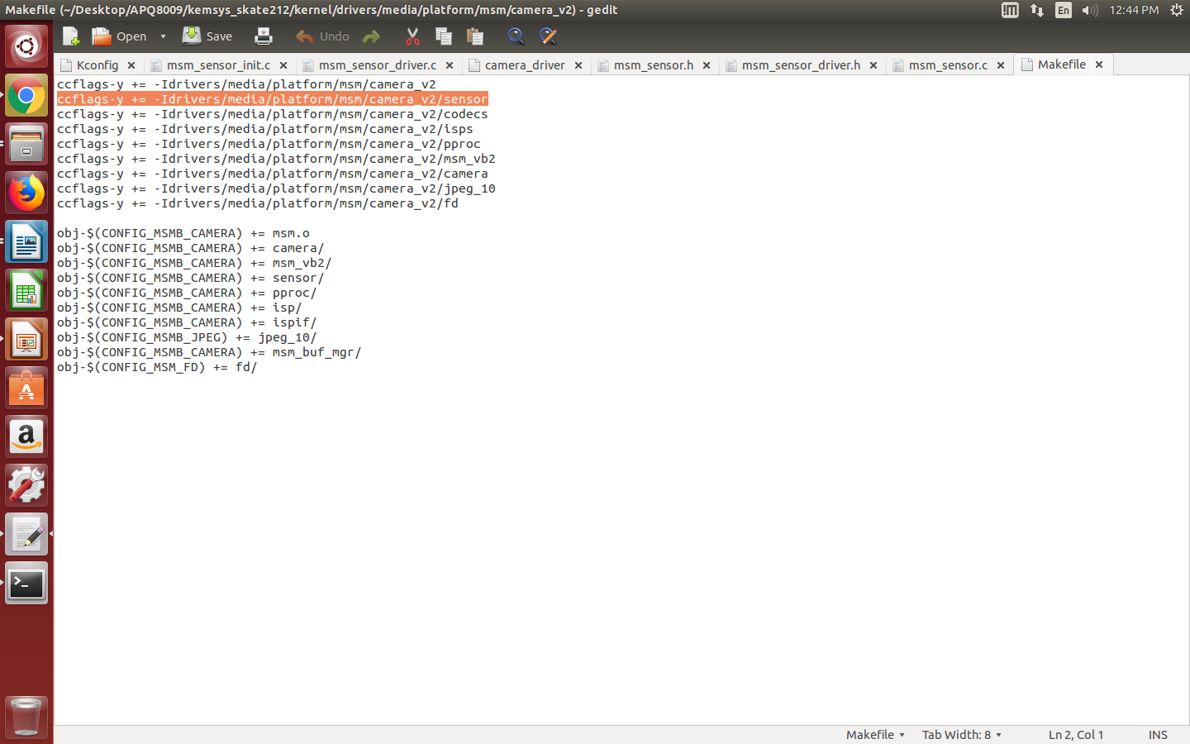
home/thontbee/Desktop/APQ8009/kemsys_skate212/kernel/drivers/media/platform/msm/camera_v2/Makefile

Slide 24
Platform CMOS driver code
home/thontbee/Desktop/APQ8009/kemsys_skate212/kernel/drivers/media/platform/msm/camera_v2/sensor/msm_sensor.c & msm_sensor_driver.c & msm_sensor_init.c

Slide 25

Thank you
8

